Slide 1
Queue

Slide 2
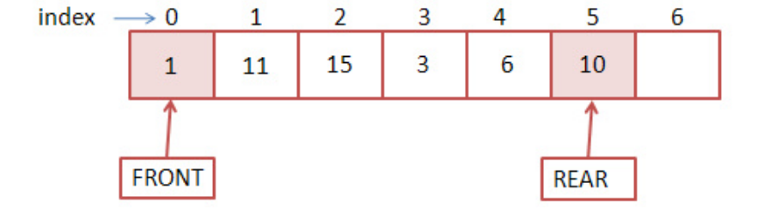
Queue
FIFO(First In First Out)
Two Ends
Front End
Rear End

Slide 3
IMPLEMENTATION OF A QUEUE
Queues can be implemented using two data structures:
Arrays/Lists
Linked lists

Slide 4
Implementation of Queues Using Arrays

Slide 5
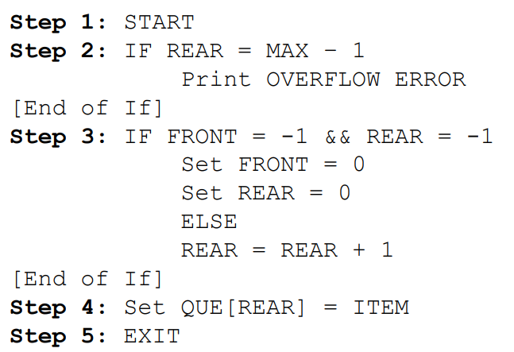
Algorithm for Inserting a New Element in a Queue

Slide 6
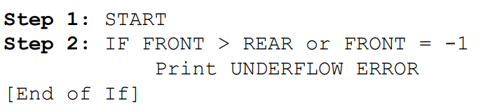
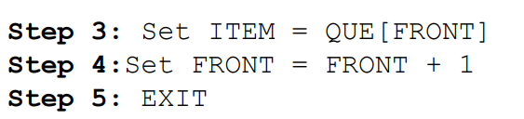
Algorithm for Deleting a Element from a Queue

Slide 7
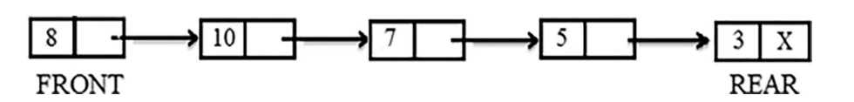
Implementation of Queues Using Linked Lists

Slide 8
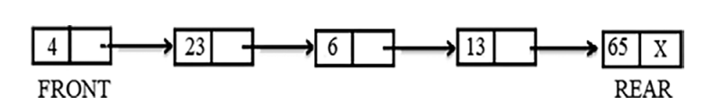
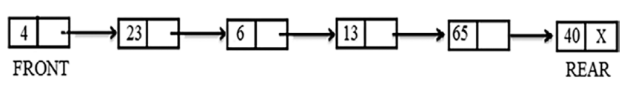
Insertion in Linked Queues

Slide 9
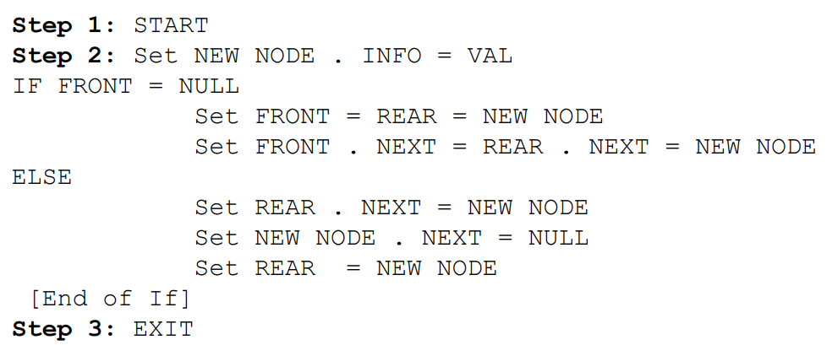
Algorithm for Inserting a New Element

Slide 10
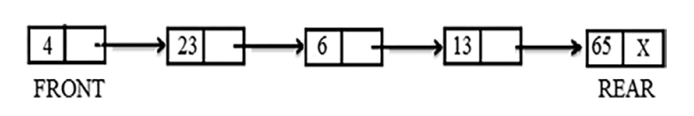
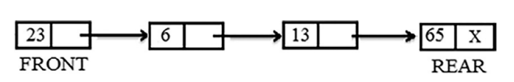
Deletion in Linked Queues

Slide 11
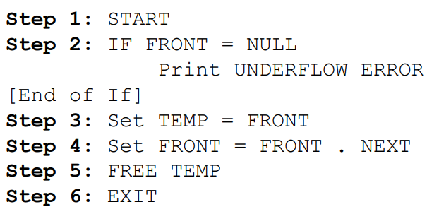
Algorithm for Deleting an Element

